Slide 1
Data Modelling, Management and Governance CIS108-6
Lecture 4
Database Design
(Conceptual, Logical, Physical and Normalisation)
Gangmin Li

Slide 2
What have we learnt?
Data Modelling
Entity Relationship Modelling (ERM) (Database Conceptual Design)
ER Representation - ER Diagram
Chen’s notation
Crow’s Foot notation
Relational Data Model (RDM - table)
(Database Logical design)

Slide 3
Review
Data Management Systems
A system that defining, unifying and managing data in its entire lifecycle to achieve accurate and efficient of data usage. A data management system will be looking into: Data governance, Data modelling and design, Data storage architecture and management, Data security and integration and Data usage (data mining, analysis and BI)
Database Management Systems (DBMS)
A Database Management System (DBMS) is a system designed to store, manage, and facilitate access to databases to ensure data security and data integrity. Functions are including operational and maintenance operations.
Types: Hierarchical, Network, Relational (RDBMS), Object-Oriented (O-ODBMS), NoSQL and Graph databases

Slide 4
Database Management System (DBMS)
Report
Application
1
Application
2
Enquiry
Retrieve
Update
Delete
Database Management System
Control
Security
Integrity
DATA
STORE
Data is controlled by a Database Management System

Slide 5
DBMS Functions
Data Storage, retrieval & update
Provides a user accessible catalogue
Including transaction support
Services:
Concurrency control
Data recovery
User authorisation
Range of data communication interfaces
Maintains data integrity
Provides data independency
Enables performance monitoring

Slide 6
Types of Database Management Systems
Hierarchical
Network
Relational (R-DBMS)
Object-Oriented (O-ODBMS)
Hybrid (Object-Relational)
Multimedia
NoSQL
Probabilistic
Notes:
For further examples of different types refer :
http://www.personal.psu.edu/glh10/ist110/topic/topic07/topic07_06.html

Slide 7
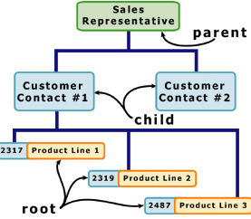
Hierarchical DB

Slide 8
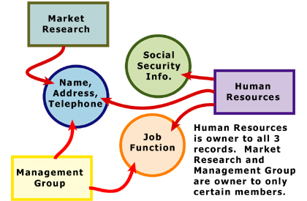
Network Databases

Slide 9
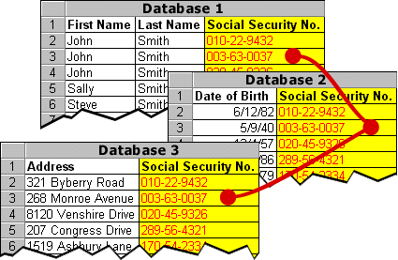
Relational Database

Slide 10
Relational Database (based on Codd’s Relational Data model -12 rules )
A model proposed by Edgar . F. Codd (1970)
A great strength of the RD model is its simple logical structure
“A data model that represents data in the form of tables or relations” (Hoffer 1999)
“A table is in more traditional parlance (terms), a file. A table has rows and columns, which, more traditionally, are known as records and fields/attributes” (Chester & Athwall 2002)
Every relation has a name and is made up of named attributes (columns) of data. Each row of each column contains one value per attribute (attribute values)

Slide 11
Modelling and Formalisation
not clearly
specified
Task
UML
Class
Diagram
modelling
SSM
ERD/ERM
Normalization
UML
Use Case
Diagram
fuzzy
Model
formalisation
UML
Activity
Diagram
Formal
language
Machine

Slide 12
Database Development Process
Requirements collection and analysis (system & data)
Develop Conceptual Data Model (ERM)
Develop Logical Data Model (Normalisation)
Database Design (RDM)
Table Definitions
Physical Design
Build Database
Notes:
A conceptual data model creates relationships between information sources, users, and business process steps.
The conceptual data model is used to develop a logical data model based on one of the primary DBMS types: relational, hierarchical, network, or object-oriented approaches.
With the logical data model in hand, developers move to the physical design, which involves determining the specific storage and access methods and structures.

Slide 13
Outline
Entity Relationship Modelling (ERM) – Conceptual design
ER Representation - ER Diagram
Chen’s notation
Crow’s Foot notation
Relational Data Model (RDM - table) – Logical design
ERM to RDM Conversion

Slide 14
What is relational data model?
A relational data model (in RDBMS) represents and stored in a table.
Rows in the table represent a collection of related data (object, record). These rows in the table denote a real-world entity or relationship.
The table name and column names are helpful to interpret the meaning of values in each row.

Slide 15
Terminology
Relation: A table with columns and rows
Tuple: A row of a relation
Attribute: A named column of a relation (also called as FIELD)
Domain: A set of allowable values for 1 or more attributes
Degree: The number of attributes it contains
Cardinality: The number of rows/tuples it contains
RDB: A collection of normalised relations with distinct relation names

Slide 16
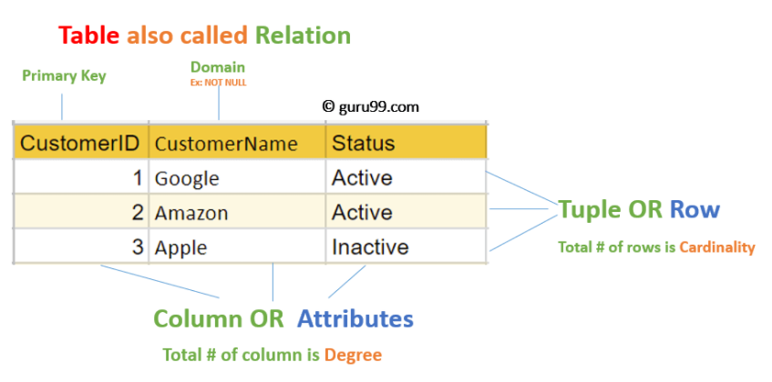
Relational Data Model (in Table)

Slide 17
Relation data model constraints
Every relation has some conditions that must hold for it to be a valid relation. These conditions are called Relational Integrity Constraints.
Key constraints
Domain constraints
Referential integrity constraints
Some other constraints are ….
No duplicated rows
No necessary order to the rows (top to bottom)
No necessary order to the columns (left to right)
Each attribute value is atomic (Each cell contains one and only one data value)
etc.

Slide 18
Outline
What is Database design?
Concepts of Functional Dependencies
Normalization
Redundancy & Anomalies
Normal forms
Process of normalization

Slide 19
Database Design
What is ?

Slide 20
What is Database Design?
Database Design is a step in the process of facilitate the designing, development, implementation and maintenance of data management systems.
The goal of databased design is easy to maintain stored data, improve data consistency and provide a cost effective data usage.
The main jobs of database design are to produce logical and physical models of the proposed database system.

Slide 21
Database Design process in DBMS
Requirements analysis
Planning – This stages of database design concepts are concerned with planning of entire Database Development Life Cycle. It takes into consideration the Information Systems strategy of the organization.
System definition – This stage defines the scope and boundaries of the proposed database system.
Database designing
Logical model – This stage is concerned with developing a database model based on requirements. The entire design is on paper without any physical implementations or specific DBMS considerations.
Physical model – This stage implements the logical model of the database taking into account the DBMS and physical implementation factors.
Implementation
Data conversion and loading – this stage of relational databases design is concerned with importing and converting data from the old system into the new database.
Testing – this stage is concerned with the identification of errors in the newly implemented system. It checks the database against requirement specifications.

Slide 22
Logical and physical design models
ERM (conceptual model)
The logical model concentrates on the data requirements and the abstract (over) view of data to be stored. It is independent of physical considerations like how the data will be stored or where it will be stored physically.
The physical data design model involves translating the logical design of the database onto physical media using hardware resources and software systems such as database management systems (DBMS).

Slide 23
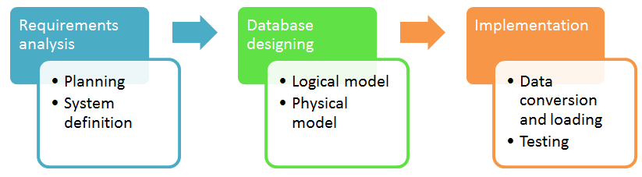
Database development life cycle
Requirements analysis
Database design
Implementation
The steps in the development life cycle do not necessarily have to be followed religiously in a sequential manner.
On small database systems, the process of database design is usually very simple and does not involve a lot of steps.

Slide 24
Database Design Techniques
Entity Relationship Model (ER Modelling- Conceptual design) is a graphical approach to database design. It is a high-level data model that defines data elements and their relationship. An ER model is used to represent real-world objects (and relations).
Normalization (logical design) is a database design technique for determining which fields belong in which tables in a relational database. So it can reduces data redundancy and eliminates undesirable characteristics like Insertion, Update and Deletion Anomalies.

Slide 25
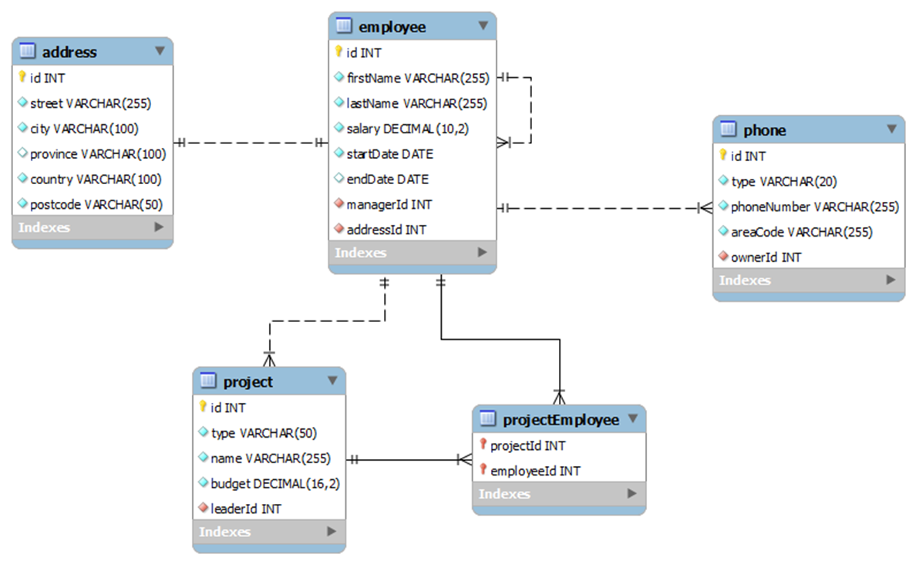
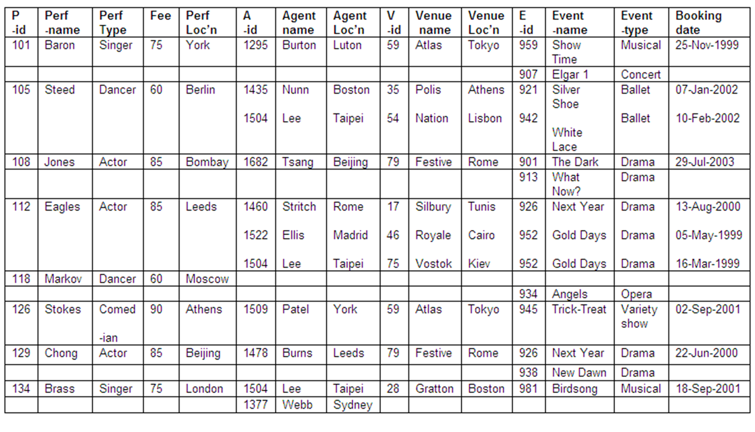
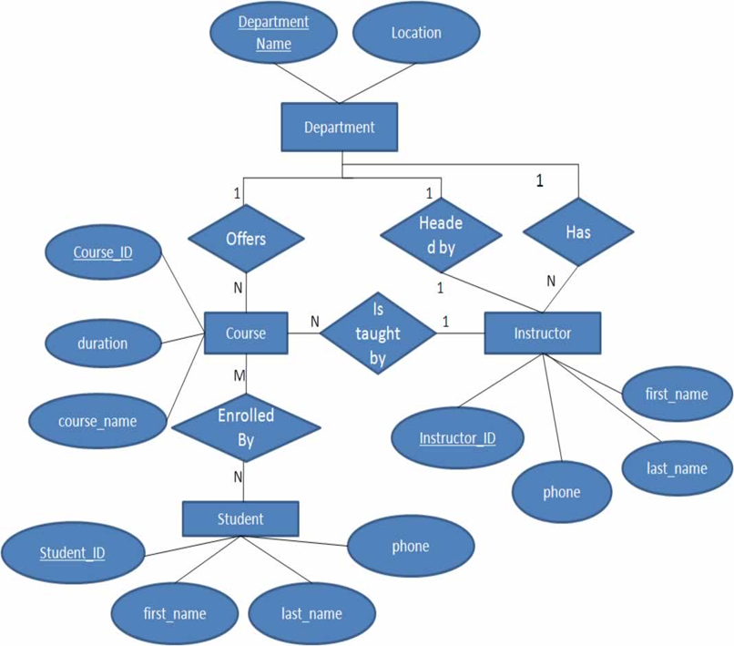
From ERM to RDM

Slide 26
ERM To RDM Conversion

Slide 27
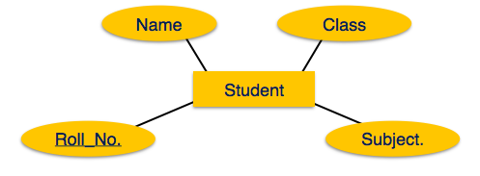
Entity Mapping
An entity is a real-world object with some attributes.
Roll_no
Name
Subject
Class
Student
Mapping Process (Algorithm)
Create table for each entity.
Entity's attributes should become fields of tables with their respective data types.
Declare primary key.

Slide 28
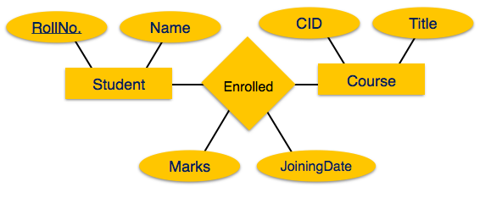
Relationship Mapping
A relationship is an association among entities.
Enrolled
* RollNo.
* CID
JoiningDate
Marks
Mapping Process
Create table for a relationship.
Add the primary keys of all participating Entities as fields of table with their respective data types.
If relationship has any attribute, add each attribute as field of table.
Declare a primary key composing all the primary keys of participating entities.
Declare all foreign key constraints.
Course
*CID
Title
Student
*RollNo
Name

Slide 29
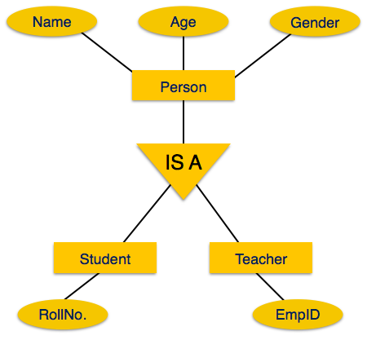
Mapping Hierarchical Entities
ERM specialization or generalization comes in the form of hierarchical entity sets.
Mapping Process
Create tables for all higher-level entities
Create tables for lower-level entities.
Add primary keys of higher-level entities in the table of lower-level entities.
In lower-level tables, add all other attributes of lower-level entities.
Declare primary key of higher-level table and the primary key for lower-level table.
Declare foreign key constraints.
Person
*NINo.
Name
Age
Gender
Student
*RollNoNINo.
Teacher
*EmpID
NINo.

Slide 30
Next Lecture
Requirements collection and analysis
Develop Conceptual Data Model
Develop Logical Data Model & Normalisation
ERM Database Design
Table Definitions
Physical Design
Build Database

Slide 31
Normalization
https://www.cseworldonline.com/dbms-tutorial/normalization-in-dbms.php
https://www.cseworldonline.com/dbms-tutorial/keys-in-dbms.php

Slide 32
What Is Normalization?
Normalization process, as first proposed by Codd (1972a), takes a relation schema (RDM) through a series of tests to certify whether it satisfies a certain normal form.
The process, which proceeds in a top-down fashion by evaluating each relation (table) against the criteria for normal forms and decomposing relations as necessary, can thus be considered as relational design by analysis.
Normalization is to minimize the redundancy from a relation or set of relations.
It is also used to eliminate the undesirable characteristics like Insertion, Update and Deletion Anomalies.
Normalization dividing the larger table into the smaller table so that the database would be much more efficient and reliable.

Slide 33
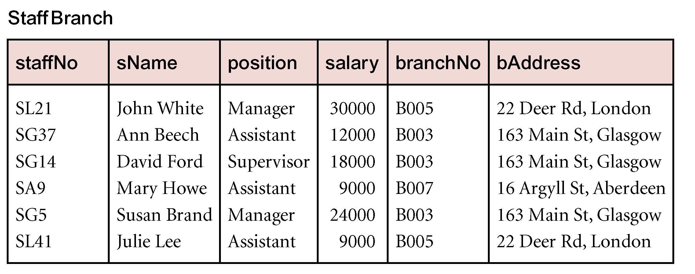
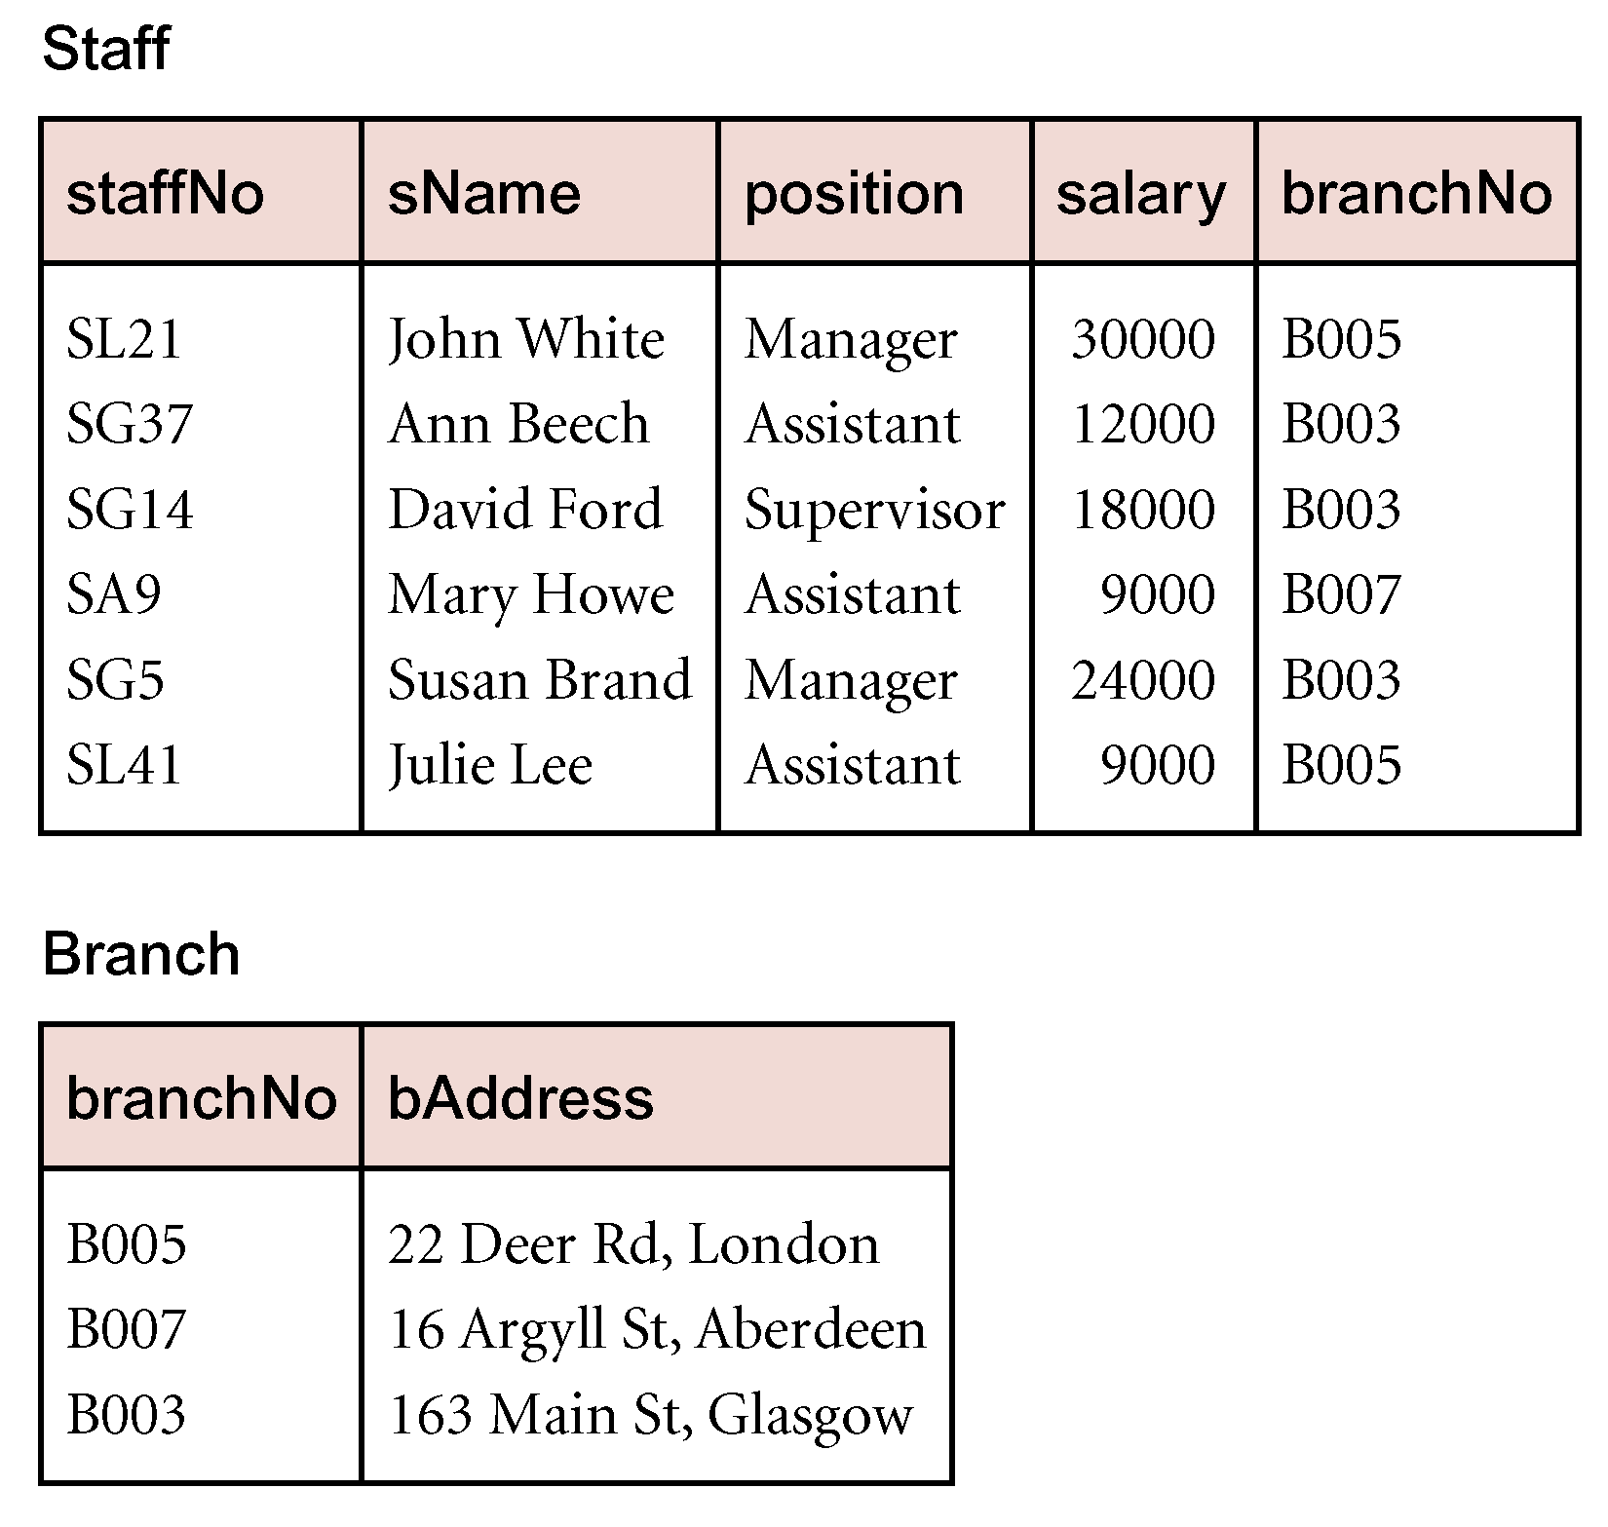
Redundancy
StaffBranch: details repeated for every member of staff located in the same branch
Branch: Details only listed once
Staff: Only the Branch number is repeated providing foreign key to Branch
Notes:
“Staff” and “Branch” are the “StaffBranch” table after normalisation

Slide 34
Anomalies
Anomalies occured due to some operations on the tables
Update Anomalies
Delete Anomalies
Insert Anomalies

Slide 35
Update Anomaly
StudentNum | CourseNum | StudentName | Address | Course
S21 | 9201 | Jones | Edinburgh | Accounts
S21 | 9267 | Jones | Edinburgh | Physics
S24 | 9267 | Smith | Glasgow | Physics
S30 | 9201 | Richards | Manchester | Accounts
S30 | 9322 | Richards | Manchester | Maths
An Update Anomaly occurs when one or more instances of duplicated data is updated, but not all. (Partial update)
For example, consider Jones moving address - you need to update all instances of Jones's address.

Slide 36
Delete Anomaly
StudentNum | CourseNum | StudentName | Address | Course
S21 | 9201 | Jones | Edinburgh | Accounts
S21 | 9267 | Jones | Edinburgh | Physics
S24 | 9267 | Smith | Glasgow | Physics
S30 | 9201 | Richards | Manchester | Accounts
S30 | 9322 | Richards | Manchester | Maths
A Delete Anomaly occurs when certain attributes are lost because of the deletion of other attributes. Or partial deletion, it means we tried to delete a record, but parts of it was left undeleted.
For example, consider what happens if Student S30 is the last student to leave the course - all information about the course is lost. So we may leave StudentNum and delete all other values.

Slide 37
Insert Anomaly
StudentNum | CourseNum | StudentName | Address | Course
S21 | 9201 | Jones | Edinburgh | Accounts
S21 | 9267 | Jones | Edinburgh | Physics
S24 | 9267 | Smith | Glasgow | Physics
S30 | 9201 | Richards | Manchester | Accounts
S30 | 9322 | Richards | Manchester | Maths
An Insert Anomaly occurs when certain attributes cannot be inserted into the database without the presence of other attributes.
For example this is the converse of delete anomaly - we can't add a new
course unless we have at least one student enrolled on the course. Or we insert data in a record that does not exist at all.

Slide 38
Benefits of normalized relational database
Elimination of redundant data storage.
Close modelling of real world entities, processes, and their relationships.
Structuring of data so that the model is flexible.
Normalization ensures that you get the benefits relational databases offer.

Slide 39
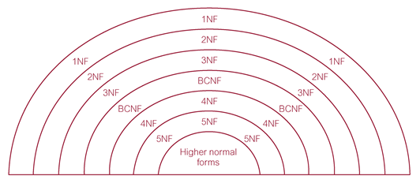
Types of Normal Forms
Each form has specific conditions.
The higher of the normal form level the better Database states.
Practically, not necessary the efficient of data Access.

Slide 40
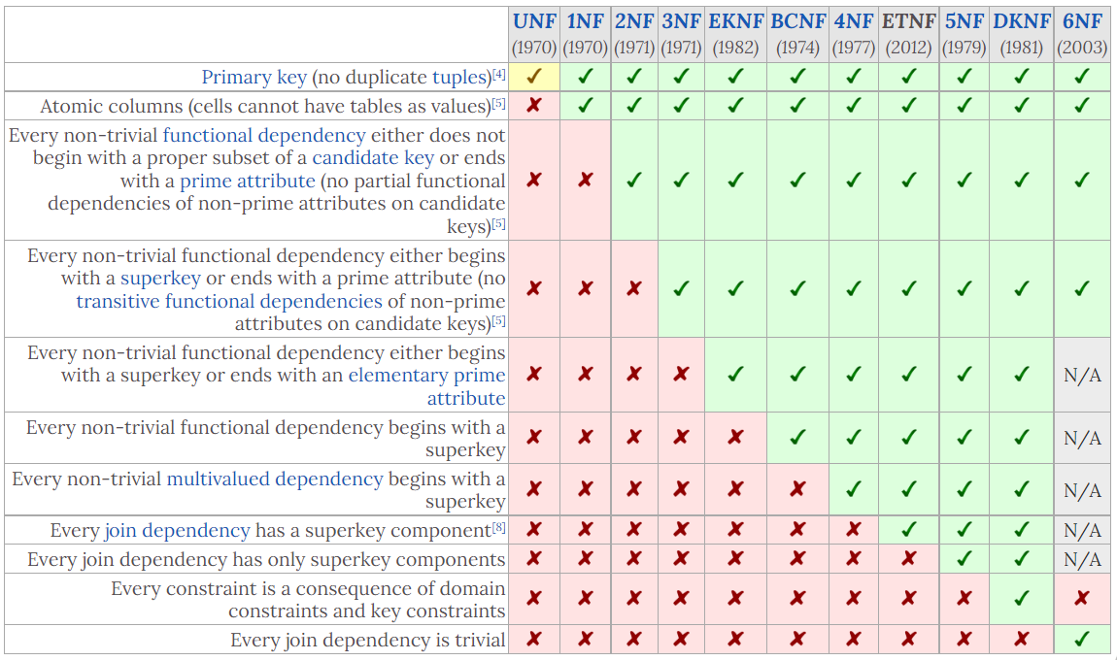
Even more Normal forms
https://www.wikiwand.com/en/Database_normalization

Slide 41
Different Normal Forms
Unnormalized form (UNF)
Is also called An unnormalized relation or non first normal form (N1NF). It has the following characteristics:
It only has a primary key.
It does not meet any of the conditions of database normalization defined by the relational model.
Database systems which support unnormalized data are sometimes called non-relational or NoSQL databases.
First Normal Form (1NF)
A relation will be 1NF if it contains an atomic value.
It states that an attribute of a table cannot hold multiple values. It must hold only single-valued attribute.

Slide 42
Other Normal Forms
Second Normal Form (2NF)
In the 2NF, relational must be in 1NF.
In the second normal form, all non-prime attributes are fully functional dependent on the primary key. NOT partially dependent on the primary key)
Third Normal Form (3NF)
A relation must be in 2NF and
No transitive dependency for no-key attributes,
3NF has to reduce the data duplication.

Slide 43
Other Normal Forms
Boyce Codd Normal Form (BCNF)
BCNF is the advance version of 3NF. It is stricter than 3NF (3.5).
A table is in BCNF
if every functional dependency X → Y, X is the super key of the table.
For BCNF, the table should be in 3NF, and for every FD (Function dependence), LHS (left hand side – determinant) is super key.
Why LHS in BCNF should be a super key and not just a candidate key?
LHS(determinant) of any Non-trivial FD in BCNF must be a Super key. It could also be a Candidate key as candidate key is also a super key. And Furthermore, if you observe, All such Non-trivial FDs where determinant is a Super key(But Not a candidate key) are having extraneous attributes on the LHS(i.e. in Determinant part) as the candidate key part of this super key itself can determine the extra attributes present in the determinant(LHS). So, It wouldn't be wrong to say that LHS(determinant) of any Non-trivial FD in BCNF must be a Candidate key But then you will have to first find the minimal FD set out of given FD set to apply this test for BCNF.

Slide 44
The key points
The higher of the normal form level the better Database states.
Consistency
Integrity
But …
Practically, not necessary the efficient of data Access.
So, it is worth noting that normal forms beyond 4NF are mainly of academic interest, as the problems they exist to solve rarely appear in practice.

Slide 45
The key points
Analysing relation data model based on their keys and on the functional dependencies among their attributes.

Slide 46
Third Normal Form (3NF)
A relation must be in 2NF and
No transitive dependency for no-key attributes,
3NF has to reduce the data duplication.
MP_ID | EMP_NAME | EMP_ZIP
222 | Harry | 201010
333 | Stephan | 02228
444 | Lan | 60007
555 | Katharine | 06389
666 | John | 462007
Example: EMPLOYEE_DETAIL table:
P_ID | EMP_NAME | EMP_ZIP | EMP_STATE | EMP_CITY
222 | Harry | 201010 | UP | Noida
333 | Stephan | 02228 | US | Boston
444 | Lan | 60007 | US | Chicago
555 | Katharine | 06389 | UK | Norwich
666 | John | 462007 | MP | Bhopal
P_ZIP | EMP_STATE | EMP_CITY
201010 | UP | Noida
02228 | US | Boston
60007 | US | Chicago
06389 | UK | Norwich
462007 | MP | Bhopal

Slide 47
Boyce Codd normal form (BCNF)
BCNF is the advance version of 3NF. It is stricter than 3NF.
A table is in BCNF if every functional dependency X → Y, X is the super key of the table.
For BCNF, the table should be in 3NF, and for every FD, LHS is super key.
Example: EMPLOYEE table:
EMP_COUNTRY table:
EMP_ID | EMP_COUNTRY | EMP_DEPT | DEPT_TYPE | EMP_DEPT_NO
264 | India | Designing | D394 | 283
264 | India | Testing | D394 | 300
364 | UK | Stores | D283 | 232
364 | UK | Developing | D283 | 549
EMP_ID | EMP_COUNTRY
264 | India
364 | UK
EMP_DEPT_MAPPING table:
EMP_DEPT table:
EMP_ID | EMP_DEPT
D394 | Designing
D394 | Testing
D283 | Stores
D283 | Developing
EMP_DEPT | DEPT_TYPE | EMP_DEPT_NO
Designing | D394 | 283
Testing | D394 | 300
Stores | D283 | 232
Developing | D283 | 549

Slide 48
Functional Dependencies
Defines relationship between attributes

Slide 49
Foundations Dependency
Functional dependency provides a theoretical foundation for Normalisation to bring database to a NORMAL states
Functional Dependency
Functional dependency (FD) is a set of constraints between two attributes in a relation.
In DBMS, FD defines a relationship between attributes of a table.
It helps in preventing data redundancy and gets to know about bad designs.

Slide 50
Functional Dependencies
For any relation R, if every valid instance of X, that value of X uniquely determines the value of Y, we say that attribute Y is functionally dependent on (FD) attribute X. it is indicated by the representation below :
X → Y
In this relationship,
X, the left side of the above FD expression is called the determinant (primary key, PK), and,
Y, the right side is the dependent (no-key attribute or non-prime attribute).
Therefore, FD defines the dependence between X, the primary key (PK) and other attributes, no-key attribute, Y.

Slide 51
Examples
In a customer relation (table), we have CustId, CustName, DoB, and Address and Tel.
Functional dependency:
CustId is functionally defines CustName or, CustName is functionally dependent on CustId.
CustId is determinant and Primary Key
DeptName is dependent attribute and non-prime attribute
What about other relations? Such as CustId, DOB and Address?
CustId | CustName | DoB | Address | Tel
c001 | John | 24031984 | Brookland | 13256732105
c002 | Mary | 08071989 | Newlinedrive | 13234872923
CustId → CustName

Slide 52
Uniquely determines
Uniquely determines means that:
If two tuples have same values for attributes A (a1, a2, ..., an), then those two tuples also have the same values for attributes B (b1, b2, ..., bm).
Then we say A Uniquely determines B.
(NOT reverse … Different A NOT necessarily results different B, It means allows different A can have the same B)

Slide 53
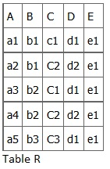


Example
In relation R, we can have:
A → B, A → C, A → D, A → E
Because A’s value are unique (a1, a2, a3, a4 and a5),
we can also have,
A → BC (or any other subset of ABCDE).
A is a primary key.
Consider B → C? (Same B must have same C) b1 has c1 and c2 so it does not hold.
Consider C → D? (Same C must have same D) c1 has d1 and c3 has d1 too. It is still unique! So C → D hold.
Cn
Cm
Ck
Dk
Two students (id) have the same name
Dm
Dn
One student (id) has two different names (persons)

Slide 54
Examples
For the given (film-cinema) relation identify the dependency relations
Fno
Name
Cno
Cname
Location
Mgno
Mname
Takings
23
Alfie
AB
Roxy
Oxford
01
Jones
200,000
23
Alfie
CH
Odeon
Telford
01
Jones
250,000
23
Alfie
MZ
Roxy
Bristol
03
Smith
350,000
31
Sin City
AB
Roxy
Oxford
01
Jones
200,000
31
Sin City
CH
Odeon
Telford
01
Jones
350,000
31
Sin City
MZ
Roxy
Bristol
03
Smith
150,000
31
Sin City
BA
Odeon
Bristol
04
Davies
400,000
76
Batman Begins
AB
Roxy
Oxford
01
Jones
200,500
76
Batman Begins
BA
Odeon
Bristol
04
Davies
355,000

Slide 55
A systematic way to determine dependency
Thumb Rule
Is determinant
Duplicate?
Yes
No
Is Dependent
Duplicate?
Member of FD
No
Yes
Not
Member of FD

Slide 56
Example
Fno
Name
Cno
Cname
Location
Mgno
Mname
Takings
23
Alfie
AB
Roxy
Oxford
01
Jones
200,000
23
Alfie
CH
Odeon
Telford
01
Jones
250,000
23
Alfie
MZ
Roxy
Bristol
03
Smith
350,000
31
Sin City
AB
Roxy
Oxford
01
Jones
200,000
31
Sin City
CH
Odeon
Telford
01
Jones
350,000
31
Sin City
MZ
Roxy
Bristol
03
Smith
150,000
31
Sin City
BA
Odeon
Bristol
04
Davies
400,000
76
Batman Begins
AB
Roxy
Oxford
01
Jones
200,500
76
Batman Begins
BA
Odeon
Bristol
04
Davies
355,000
FD
Fno → Name
Cno → Cname, Location, Mgno, Mname
{Fno, Cno} → Name, Cname, Location, Mgno, Mname, Takings

Slide 57
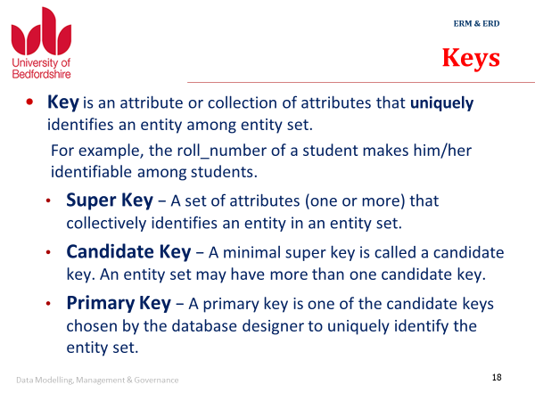
Keys from the last lecture

Slide 58
Types of Functional dependency
Functional Dependency has three forms:
Trivial Functional Dependency
Non-Trivial Functional Dependency
Completely Non-Trivial Functional Dependency
Trivial Functional Dependency
It occurs when B is a subset of A in A -> B
Example
We are considering the same <Department> table with two attributes to understand the concept of trivial dependency.
The following is a trivial functional dependency since DeptId is a subset of DeptId and DeptName
{ DeptId, DeptName } -> DeptId

Slide 59
Types of Functional dependency
Non–Trivial Functional Dependency
It occurs when B is not a subset of A in
A -> B
Example: DeptId -> DeptName
The above is a non-trivial functional dependency since DeptName is not a subset of DeptId.
Completely Non-Trivial Functional Dependency
It occurs when A and B’s intersection is null in A -> B

Slide 60
Partial Dependencies (2NF)
Partial dependency
Fno, Cno → Name, Cname, Location, Mgno, Mname, Takings
It means that Fno and Cno together determines Name, Cname, Location, Mgno, Mname and Takings
Fno and Cno are prime attributes that form the primary key together (super key, candidate key)
Dependencies based on only a part of the primary key are called partial dependencies
Examples are Fno → Name Cno → Cname, Location, Mgno, Mname

Slide 61
Example
Fno
Name
Cno
Cname
Location
Mgno
Mname
Takings
23
Alfie
AB
Roxy
Oxford
01
Jones
200,000
23
Alfie
CH
Odeon
Telford
01
Jones
250,000
23
Alfie
MZ
Roxy
Bristol
03
Smith
350,000
31
Sin City
AB
Roxy
Oxford
01
Jones
200,000
31
Sin City
CH
Odeon
Telford
01
Jones
350,000
31
Sin City
MZ
Roxy
Bristol
03
Smith
150,000
31
Sin City
BA
Odeon
Bristol
04
Davies
400,000
76
Batman Begins
AB
Roxy
Oxford
01
Jones
200,500
76
Batman Begins
BA
Odeon
Bristol
04
Davies
355,000
{Fno, Cno} → Name, Cname, Location, Mgno, Mname, Takings
Fno → Name Cno → Cname, Location, Mgno, Mname

Slide 62
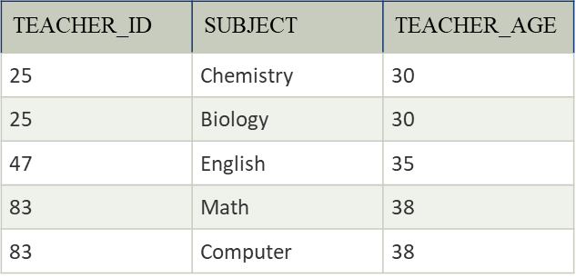
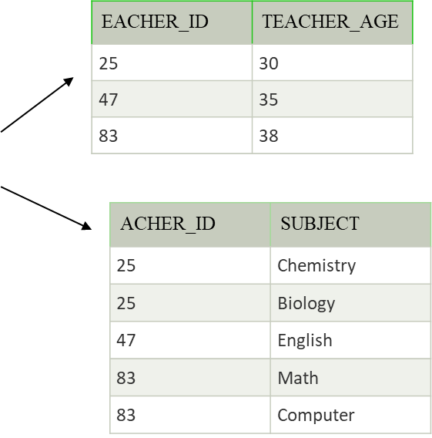
Another Tricky Situation
Does the following relation has partial dependency?
TEACHER_ID → TEACHER_AGE, So we have
TEACHER_AGE is functionally dependent on TEACHER_ID
TEACHER_AGE is non-prime attribute.
For the relation we have super key {TEACHER_ID, SUBJECT, {TEACHER_ID, SUBJECT}}, so we have candidate key {TEACHER_ID, SUBJECT},
TEACHER_ID is a proper subset of candidate key {TEACHER_ID, SUBJECT}.
IF we choose {TEACHER_ID, SUBJECT} as primary key, then the partial dependence DOES exist.

Slide 63
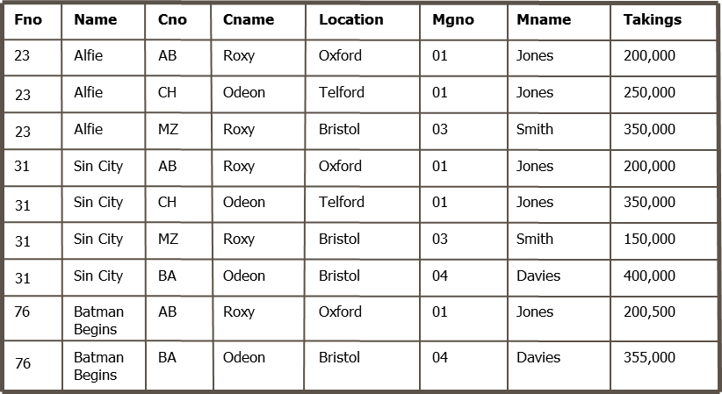
Transitive Dependencies (3NF)
A transitive dependency is a dependency of one non-prime attribute (an attribute that is not part of the primary key) to another non-prime attribute
Mgno → Mname is a transitive dependency

Slide 64
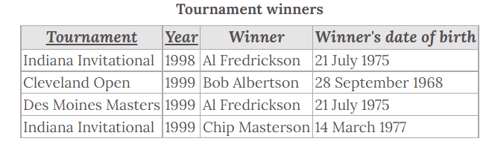
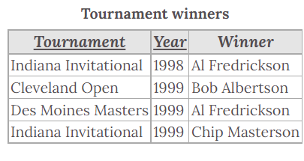
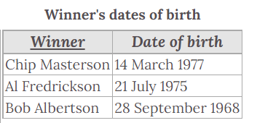
Another example

Slide 65
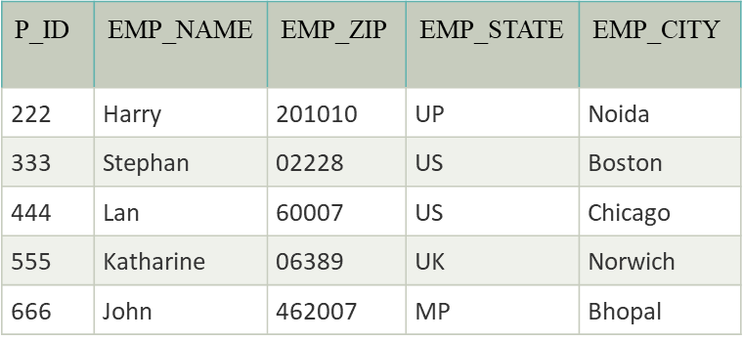
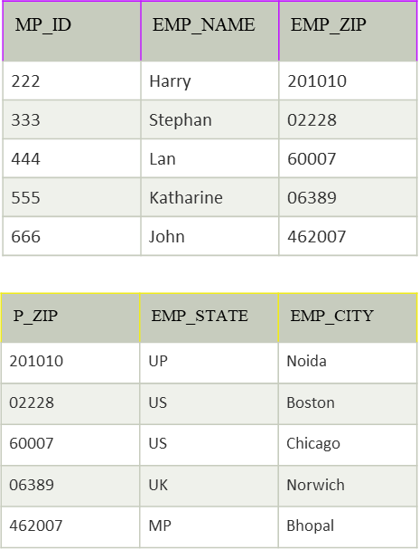
Another example
EMPLOYEE_DETAIL table

Slide 66
Dependency Diagram
A non-normalized table is one that has data redundancy in it.
A dependency diagram shows the various dependencies that exist in a non-normalized table.
The following dependencies are identified in this table:
ProjectNo and EmpNo, combined, are the PK.
{ProjectNo, EmpNo} —> ProjName, EmpName, DeptNo, DeptName, HrsWork
Partial Dependencies:
ProjectNo —> ProjName
EmpNo —> EmpName, DeptNo, DeptName
Transitive Dependency:
DeptNo —> DeptName
ProjectNo
ProjName
EmpNo
EmpName
DeptNo
DeptName
HrsWork

Slide 67
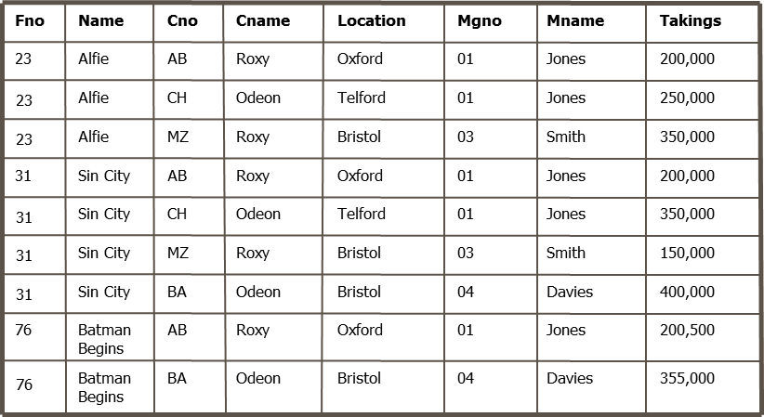
The following dependencies are identified in this table:
Fno and Cno, combined, are the PK.
{Fno, Cno} → Name, Cname, Location, Mgno, Mname, Takings
Partial Dependencies:
Fno → Name
Cno → Cname, Location, Mgno, Mname
Transitive Dependency:
Mgno → Mname

Slide 68
The Normalisation Process

Slide 69
Normalization Process in DBMS
Database normalization is a stepwise formal process that allows us to decompose database tables in such a way that both data dependency and update anomalies are minimized. It makes use of functional dependency that exists in the table and primary key or candidate key in analysing the tables.
Normalization Process generally follows the Normal forms:
First Normal Form (INF) ->
Second Normal Form (2NF) ->
Third Normal Form (3NF)

Slide 70
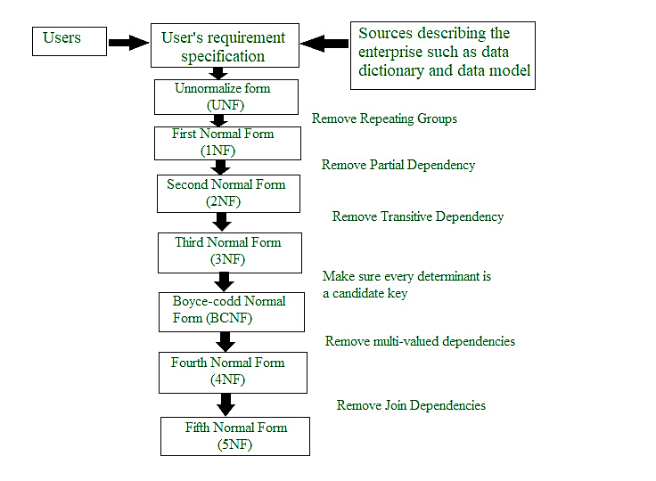

Slide 71
The Normalisation Process
First Normal Form (1NF)
A primary key must be identified
The table cannot contain repeating groups
A repeating group is a set of logically related fields or values that occur multiple times in one record.
Second Normal Form (2NF)
The table must be in 1NF.
Every non-key column must be dependent on all parts of the primary key → no partial dependencies!
Third Normal Form (3NF)
The table must be in 2NF.
No non-key column may be functionally dependent on another non-key column → no transitive dependencies!

Slide 72
Example 1
Consider the following set of data in a table ORDERITEMS:
It contains a repeating group of ITEM NUM, ITEM DESCRIPTION, QUANTITY, and PRICE
First Normal Form (1NF) prohibits repeating groups.
ORDERID DATE CUSTID CUSTNAME STATE ITEMNUM ITEMDESCR QUANTITY PRICE
2301 6/23 101 Volleyrite IL 3786 net 3 35
4011 racket 6 65
9132 3-pack 8 4
2302 6/25 107 Herman’s WI 5794 6-pack 4 5
2303 6/26 110 WR Sports MI 4011 racket 2 65
3141 cover 2 10

Slide 73
Convert to 1NF
Remove repeat groups
Determine primary key (different possibilities): ORDERID, ITEMNUM
ORDERID, ITEMNUM → DATE, CUSTID, CUSTNAME, STATE,ITEMDESCR, QUANTITY, PRICE
Resulting new table ORDERITEMS:
ORDERID DATE CUSTID CUSTNAME STATE ITEMNUM ITEMDESCR QUANTITY PRICE
2301 6/23 101 Volleyrite IL 3786 net 3 35
2301 6/23 101 Volleyrite IL 4011 racket 6 65
2301 6/23 101 Volleyrite IL 9132 3-pack 8 4
2302 6/25 107 Herman’s WI 5794 6-pack 4 5
2303 6/26 110 WR Sports MI 4011 racket 2 65
2303 6/26 110 WR Sports MI 3141 cover 2 10

Slide 74
Convert to 2NF
The goal is to eliminate partial dependencies
Identify all partial dependencies of the form P → A with P as prime attribute(s) (part of the primary key) and A as dependent attribute(s)
For each partial dependency P → A:
Create a new relation/table with attribute(s) P as primary key and attribute(s) A as value.
Determine a decent name for the table.
Remove attribute(s) A from the original table, make P foreign key(s) to the new table

Slide 75
Convert to 2NF
The original table ORDERITEMS is not in 2NF because
ITEMNUM → ITEMDESCR, PRICE
ORDERID → DATE, CUSTID, CUSTNAME, STATE
Create new tables:
ITEM
ORDER_ITEM
ITEMNUM ITEMDESCR PRICE
ORDERID ITEMNUM QUANTITY
3786 net 35
4011 racket 65
9132 3-pack 4
6-pack 5
3141 cover 10
2301 3786 3
2301 4011 6
2301 9132 8
2302 5794 4
2303 4011 2
2303 3141 2
ORDER
ORDERID DATE CUSTID CUSTNAME STATE
2301 6/23 101 Volleyrite IL 2302 6/25 107 Herman’s WI
2303 6/26 110 WR Sports MI

Slide 76
Convert to 3NF
The goal is to eliminate transitive dependencies (non-key dependencies)
Identify all transitive dependencies of the form A → B with A as non-prime attribute(s) (not part of the primary key) and B as dependent attribute(s)
For each transitive dependency A → B:
Create a new relation/table with attribute(s) A as primary key and attribute(s) B as value.
Determine a decent name for the table.
Remove attribute(s) B from the original table, make A foreign key(s) to the new table (in original table)

Slide 77
Convert to 3NF
ITEM and ORDER_ITEM are only in 3NF (why?)
We can find a transitive dependency in ORDER:
CUSTID → CUSTNAME, STATE
Create a new table CUSTOMER and modify table ORDER
ORDER
ORDERID DATE CUSTID (FK)
CUSTOMER
2301 6/23 101 2302 6/25 107 2303 6/26 110
CUSTID CUSTNAME STATE
Volleyrite IL
107 Herman’s WI
110 WR Sports MI

Slide 78
Normalisation: Discussion
We have seen how normalisation removed redundancies and anomalies
Normalisation is thus very useful or even crucial for operational data
However, it comes at a price:
We split our data into several tables. To combine them again (e.g. for reporting), we need JOIN operations (cf SQL JOINs)
JOIN operations are expensive when it comes to processing and memory resources, in particular, with large amounts of data
Normalisation often does not make sense in applications where redundancy and anomalies are a minor issue, for example
Data Analytics / Data Warehousing
‘Big Data’, log file analysis

Slide 79
Summary
Normalisation: A important DBMS design technique supplement to Data modelling (ERM).
Normalisation is build based on Functional Dependencies
Normalisation removes redundancy and anomalies
Delete Anomalies
Update Anomalies
Insert Anomalies
3 Normal forms: 1NF, 2NF, 3NF, …
Process of Normalization UNF → 1NF → 2NF → 3NF

